Slide 1
TensorFlow EcoSystem
-Summary
-Summary
-Summary
Jack Wu

Slide 2
Part 1: Processor
In this part, we will discuss the supported hardware by TensorFlow.

Slide 3
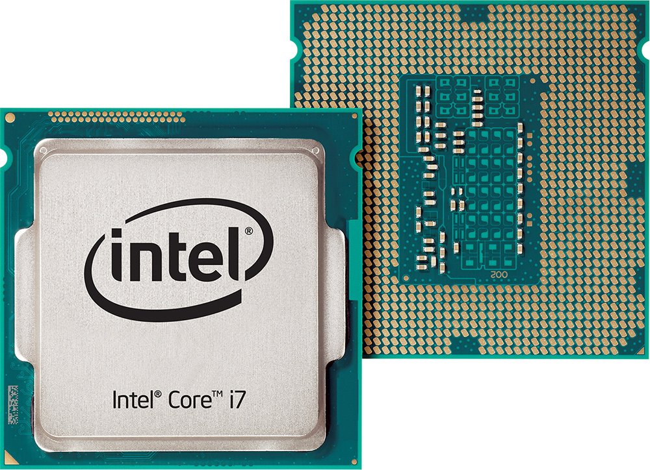
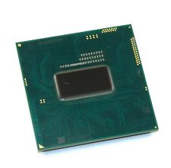
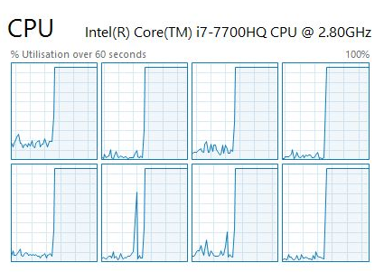
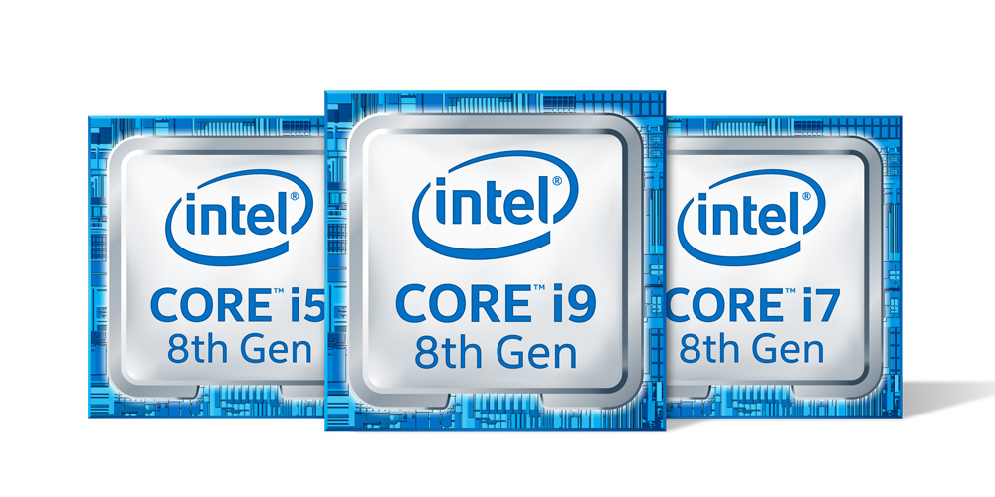
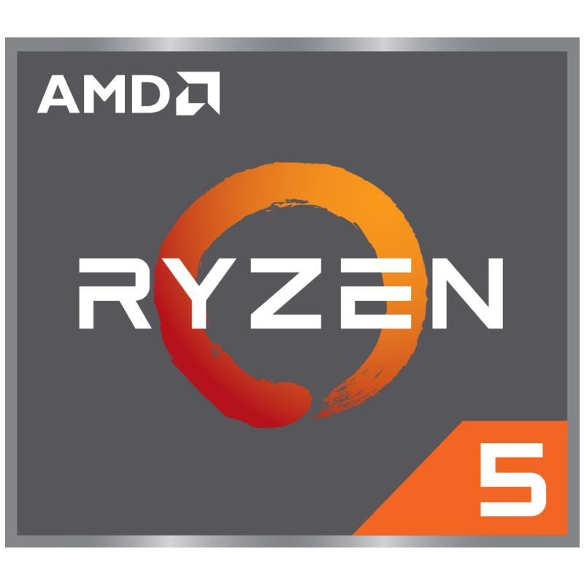
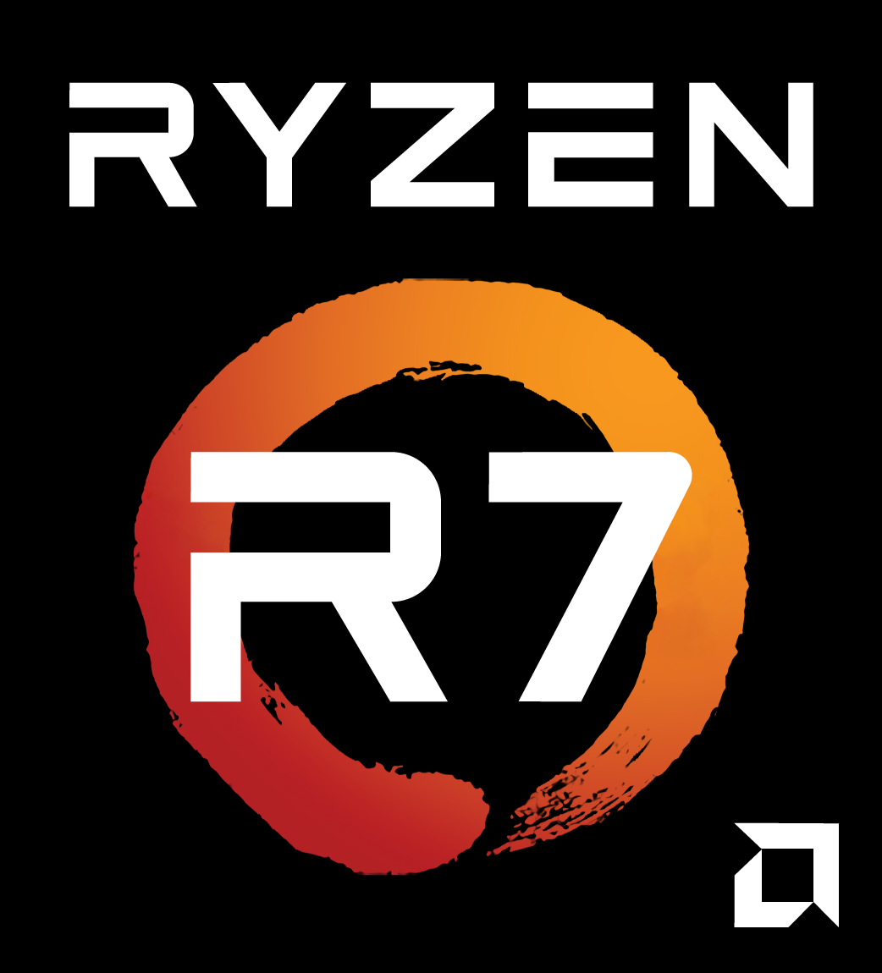
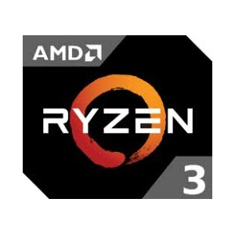
CPU The computer used to record this course uses an intel i7-7700HQ CPU.
Top: Desktop CPU / Mobile CPU.
Bottom: CPU Status in Task Manager.
CPU stands for Central Processing Unit.
Every computer has a CPU. It is like the heart of a human.
Two of the most famous CPU makers are intel and AMD.
You might have a intel Core i7 or a AMD Ryzen R7 in your computer!
CPU has several computing ‘Cores’. Each core process one task at one time. Some CPU has ‘Hyper-threading Technology’ so one core can run multiple threads of task in the same time.
Core 1
Thread 1
Core 1
Thread 2
Core 2
Thread 1
Core 2
Thread 2
Core 3
Thread 1
Core 3
Thread 2
Core 4
Thread 1
Core 4
Thread 2
Read More: Hyperthreading (https://en.wikipedia.org/wiki/Hyper-threading)

Slide 4
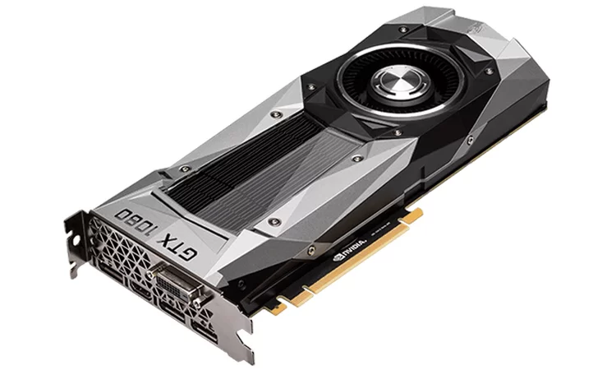
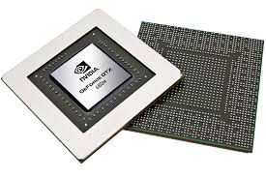
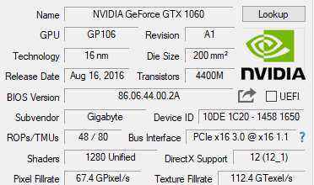
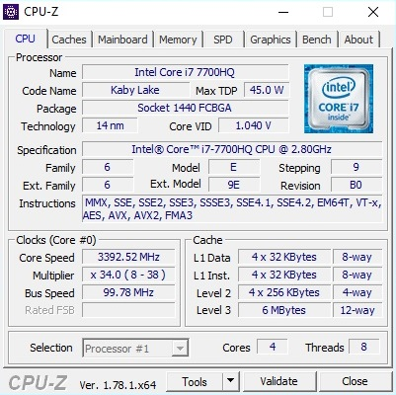
GPU The computer used to record this course uses a NVIDIA GeForce GTX 1060 GPU.
GPU stands for Graphic Processing Unit.
Mostly for gaming, but you can also train ML models with it!
It has thousands of small computing units, and runs thousands of tasks simultaneously. Therefore MUCH more efficient than CPU. (e.g. 1280 GPU CUDA Cores vs. 4 CPU Cores)
Two most famous GPU makers: NVIDIA and AMD.
NVIDIA: GeForce(Consumer), Quadro(Professional), Tesla(Accelerator)
AMD: Radeon(Consumer), Radeon Pro(Professional)
Up: Spec for GPU
Down: Spec for CPU

Slide 5
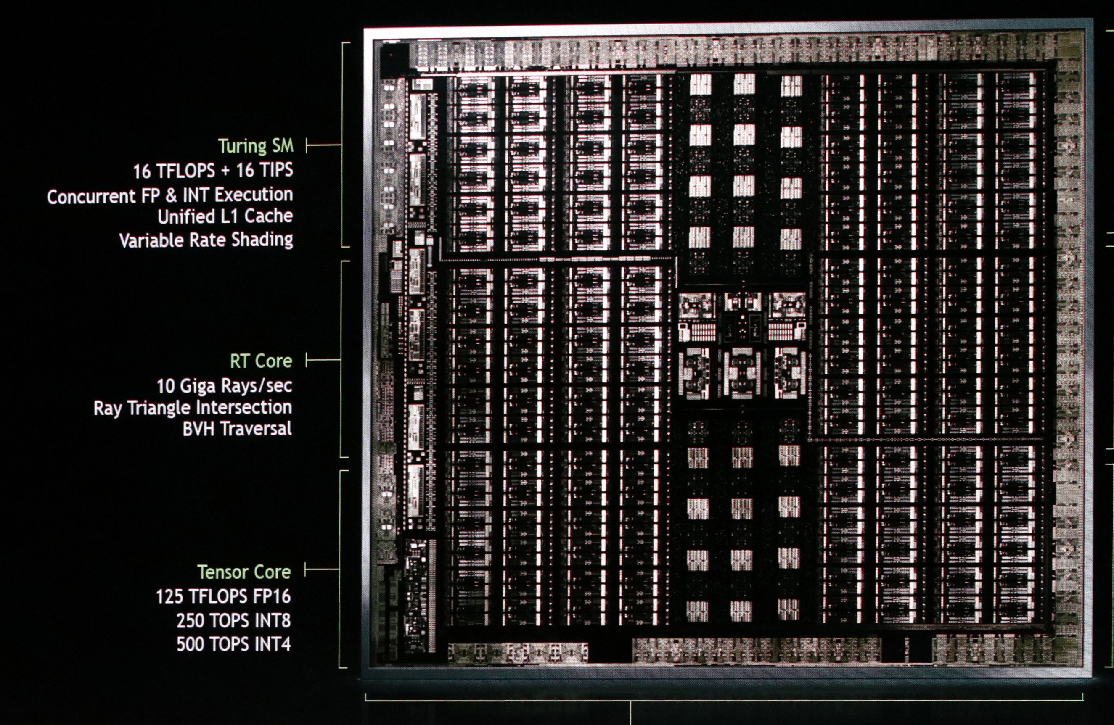

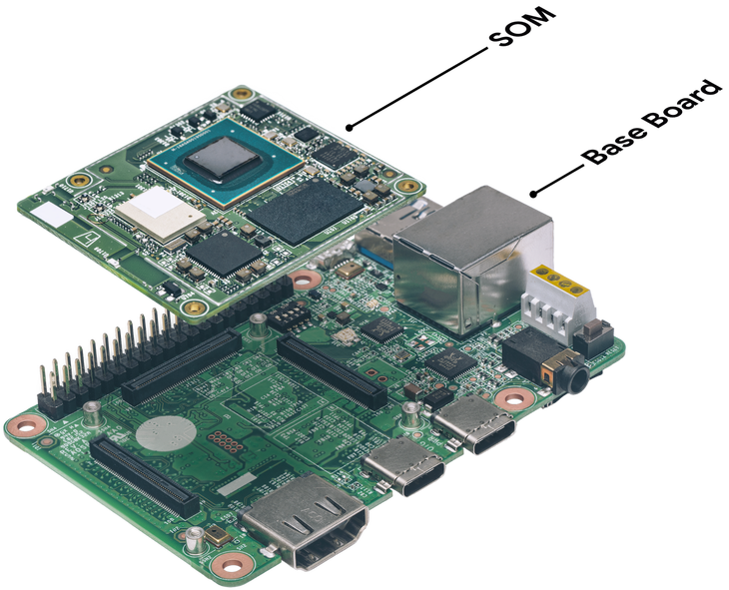
TPU
TPU stands for Tensor Processing Unit.
Google developed TPU specifically for AI Training.
NVIDIA also put “Tensor Cores” into their newest Turing and Volta architecture GPU.
Top: NVIDIA “Turing” GPU
Bottom: A Google TPU.
Image Credit: https://techcrunch.com/2018/07/25/google-is-making-a-fast-specialized-tpu-chip-for-edge-devices-and-a-suite-of-services-to-support-it/

Slide 6
Processor TensorFlow runs on three type of processors: CPU, GPU, and TPU.
TensorFlow can run on a Central Processing Unit(CPU) that every computer has.
GPU stands for Graphic Processing Unit. GPU has a lot of small computing cores, and can boost up the training speed by running them simultaneously in every small core.
TPU stands for Tensor Processing Unit, which is a chip Google developed specifically for Machine Learning. However, the new NVIDIA Turing and Volta GPU cards also have ‘Tensor Core’ for tensor computing.

Slide 7
Part 2: Platform: Personal Computing
In this part we will talk about the software platforms that TensorFlow runs on.

Slide 8
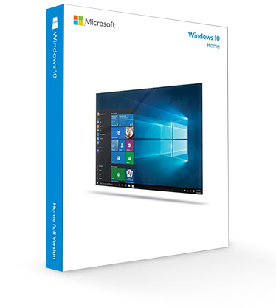
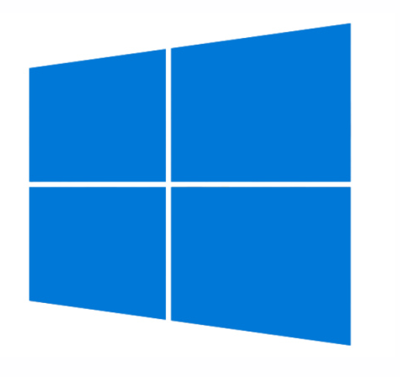
Windows
Windows is the most used operating system in the world!
It is also the easiest OS for beginners comparing to Linux.
According to a Stack Overflow "Web Developer Survey Results 2018" survey, 49.4% developers use Windows as their work operating system[1].
This course is recorded using Windows 10!
[1]: https://insights.stackoverflow.com/survey/2018/#development-environments-and-tools

Slide 9
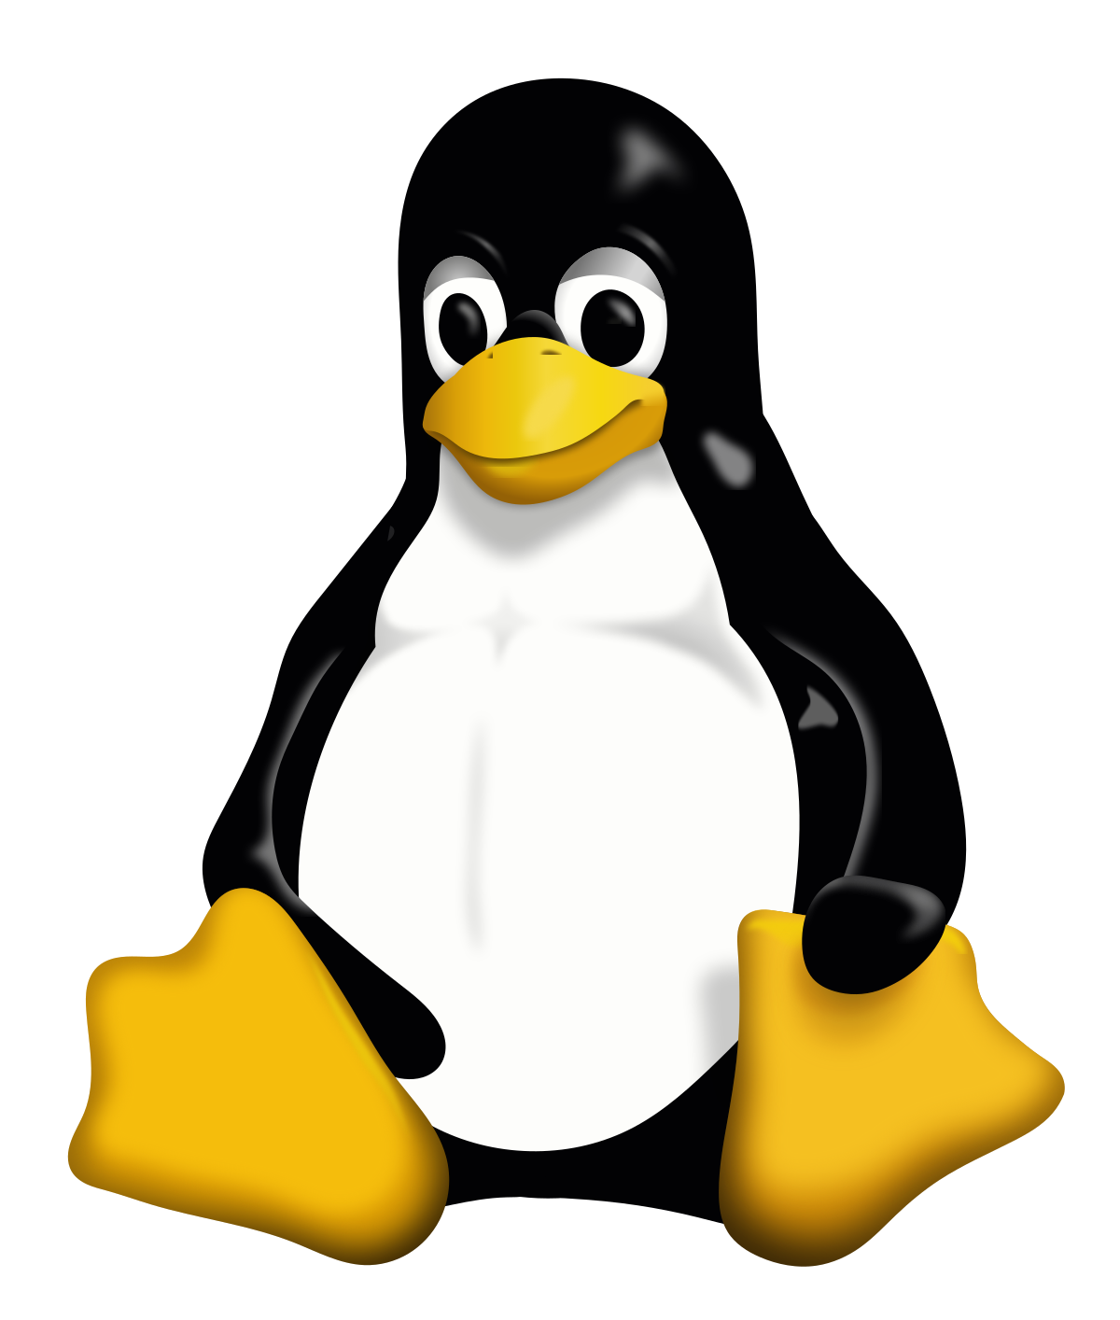

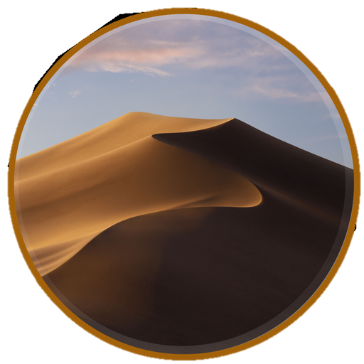
Linux / macOS
Linux has many distributions sharing the same Linux kernel, and the most popular one is Ubuntu. There are also others: centOS, Arch, Fedora,
macOS, along with many Linux distributions, uses a kernel (Unix) that is similar to the one used in Linux distributions.
About 27.4% developers use macOS, and about 23.0% developers use Linux.[1]

Slide 10
Platform: Personal Computing
Windows:
The most used operating system for humans these days.
TensorFlow runs on Windows with a Python environment. This is the platform that this course will be recorded in.
Linux:
Natively supports Python, so TensorFlow runs on all distributions of Linux.
Linux has many distribution versions, but they all are based on the same kernel. The most popular distribution is Ubuntu.
macOS:
macOS uses Unix as its kernel, which is similar to Linux.
Therefore, macOS users will have a similar user experience with those who uses Linux.

Slide 11
Part 3: Platform: Mobile
In this part we will talk about the software platforms that TensorFlow runs on.

Slide 12
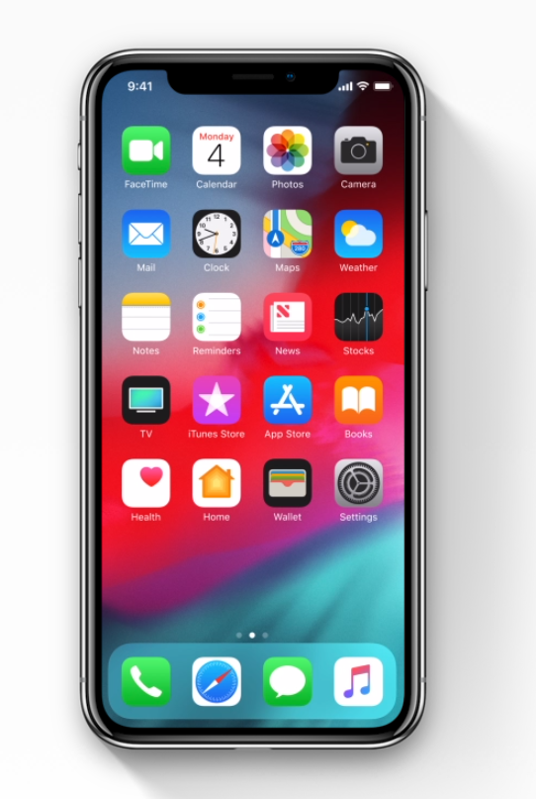
iOS
TensorFlow can also run in iOS.
Apple now have 1.3 Billion devices running iOS, and there are 2 million apps in the APP Store.[1]
iOS not only allow apps run on iPhone, but also iPad and iPod!
[1]: https://www.macrumors.com/2018/02/01/apple-now-has-1-3-billion-active-devices-worldwide/

Slide 13

Android
Google also developed Android, so Tensorflow is well supported by Android.
There are over 2 Billion Android devices around the world and over 3 million Android APP! [1]
Mobile computing power are getting better and better every year, many mobile chip companies like Snapdragon also added in AI processing unit into their mobile chips.
[1]: https://www.theverge.com/2017/5/17/15654454/android-reaches-2-billion-monthly-active-users

Slide 14
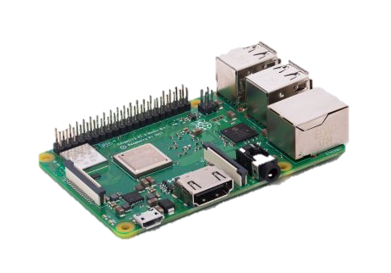
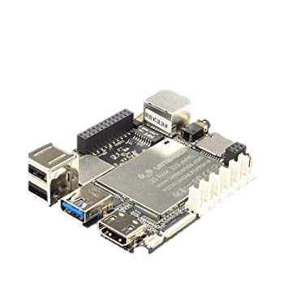
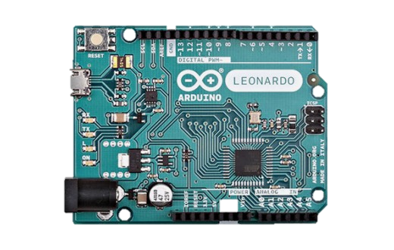
Single-Chip Microcomputers
A Raspberry Pi board that runs Linux based Raspbian OS.
Probably the most famous single chip microcomputers is the Raspberry Pi.
Raspberry Pi runs on Raspbian, which is an OS based on Linux —— so it is supported!
Some others use Windows as OS, like LattePanda, which is also supported.
TensorFlow cannot run on Arduino.
A LattePanda board that runs Windows 10.
An Arduino board.

Slide 15
Platform: Mobile
iOS:
TensorFlow is supported on iOS. There are millions of iOS devices in the world now.
Building TensorFlow on iOS Documents: https://www.tensorflow.org/mobile/ios_build
Android:
Since Google developed Android, TensorFlow also runs on Android
By implementing machine learning to mobile devices we can make machine learning more accessible and friendly to humans.
Single-chip Microcomputer:
They all run on a Linux or Windows based operating system, so they are supported as well!
Arduino is not supported.

Slide 16
Part 4: Cloud Computing (Optional)
In this part we will talk about Cloud Computing.

Slide 17
TensorFlow Distributed Execution Engine
In machine learning, the most time consuming process is training the model. Therefore, the TensorFlow Distributed Execution Engine is able to distribute task to many, sometimes hundreds and thousands of machines to boost up the training speed.

Slide 18
Amazon AWS
Amazon AWS stands for Amazon Web Services, which “offers reliable, scalable, and inexpensive cloud computing services. Free to join, pay only for what you use.”
Data scientists in the industry usually find it useful to rent some resources on AWS when they have massive data to train a complicated model.
URL: https://aws.amazon.com/

Slide 19
Part 5: Language
In this part we will talk about computer programming languages in TensorFlow.

Slide 20
END

Slide 21
UNUSED SLIDES

Slide 22
Instructions for use
EDIT IN GOOGLE SLIDES
Click on the button under the presentation preview that says "Use as Google Slides Theme".
You will get a copy of this document on your Google Drive and will be able to edit, add or delete slides.
You have to be signed in to your Google account.
EDIT IN POWERPOINT®
Click on the button under the presentation preview that says "Download as PowerPoint template". You will get a .pptx file that you can edit in PowerPoint.
Remember to download and install the fonts used in this presentation (you’ll find the links to the font files needed in the Presentation design slide)
More info on how to use this template at www.slidescarnival.com/help-use-presentation-template
This template is free to use under Creative Commons Attribution license. You can keep the Credits slide or mention SlidesCarnival and other resources used in a slide footer.

Slide 23

Hello!
I am Jayden Smith
I am here because I love to give presentations.
You can find me at @username

Slide 24
1.
Transition headline
Let’s start with the first set of slides

Slide 25
“Quotations are commonly printed as a means of inspiration and to invoke philosophical thoughts from the reader”

Slide 26
This is a slide title
Here you have a list of items
And some text
But remember not to overload your slides with content
Your audience will listen to you or read the content, but won’t do both.

Slide 27
Big concept
Bring the attention of your audience over a key concept using icons or illustrations

Slide 28
You can also split your content
White
Is the color of milk and fresh snow, the color produced by the combination of all the colors of the visible spectrum.
Black
Is the color of coal, ebony, and of outer space. It is the darkest color, the result of the absence of or complete absorption of light.

Slide 29
In two or three columns
Yellow
Is the color of gold, butter and ripe lemons. In the spectrum of visible light, yellow is found between green and orange.
Blue
Is the colour of the clear sky and the deep sea. It is located between violet and green on the optical spectrum.
Red
Is the color of blood, and because of this it has historically been associated with sacrifice, danger and courage.

Slide 30
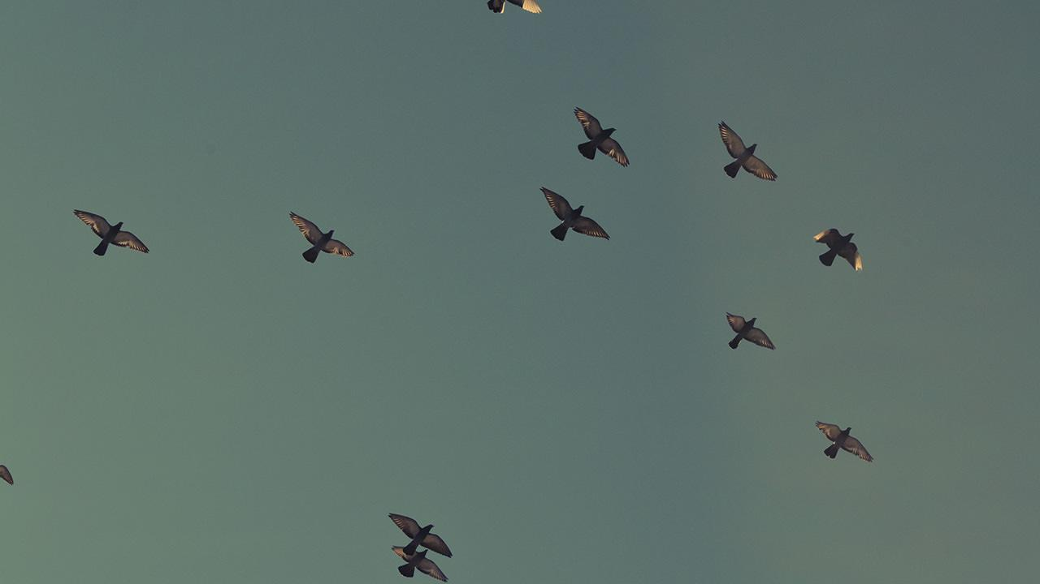
A picture is worth a thousand words
A complex idea can be conveyed with just a single still image, namely making it possible to absorb large amounts of data quickly.

Slide 31
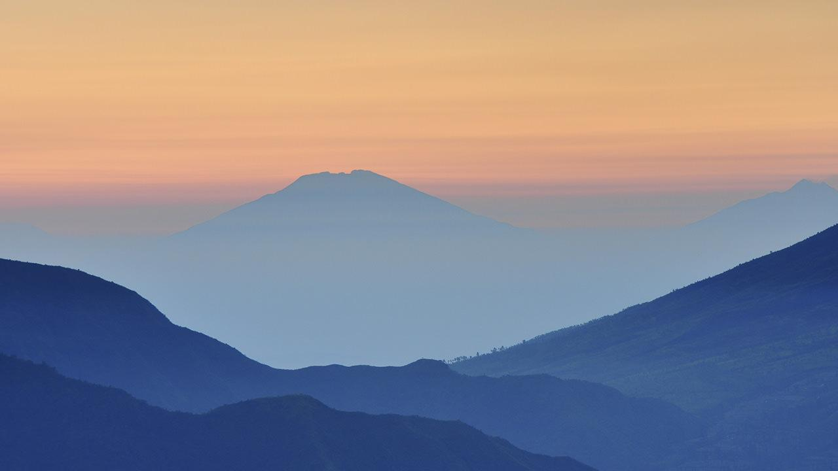
Want big impact?
Use big image.

Slide 32
Use charts to explain your ideas
White
Gray
Black

Slide 33
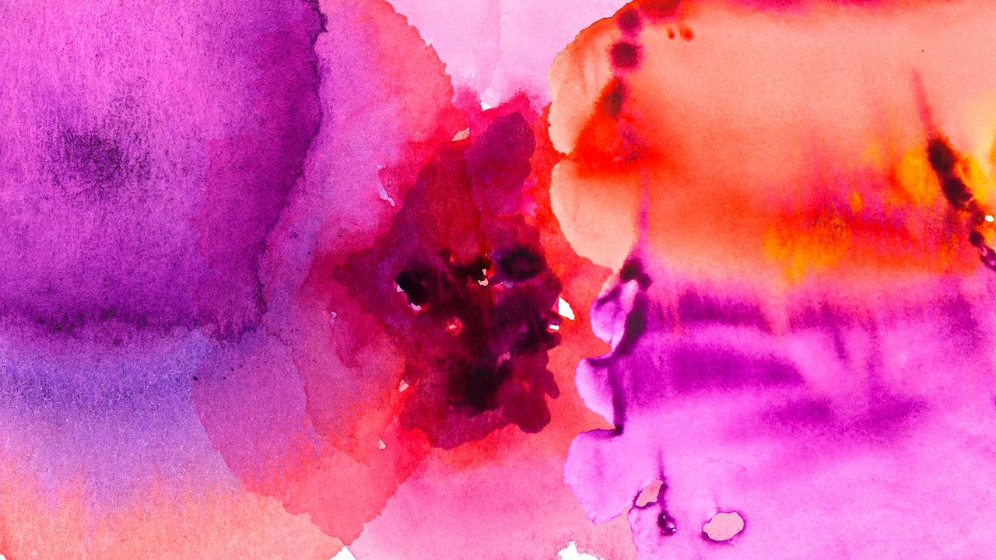
And tables to compare data
 | A | B | C
Yellow | 10 | 20 | 7
Blue | 30 | 15 | 10
Orange | 5 | 24 | 16

Slide 34
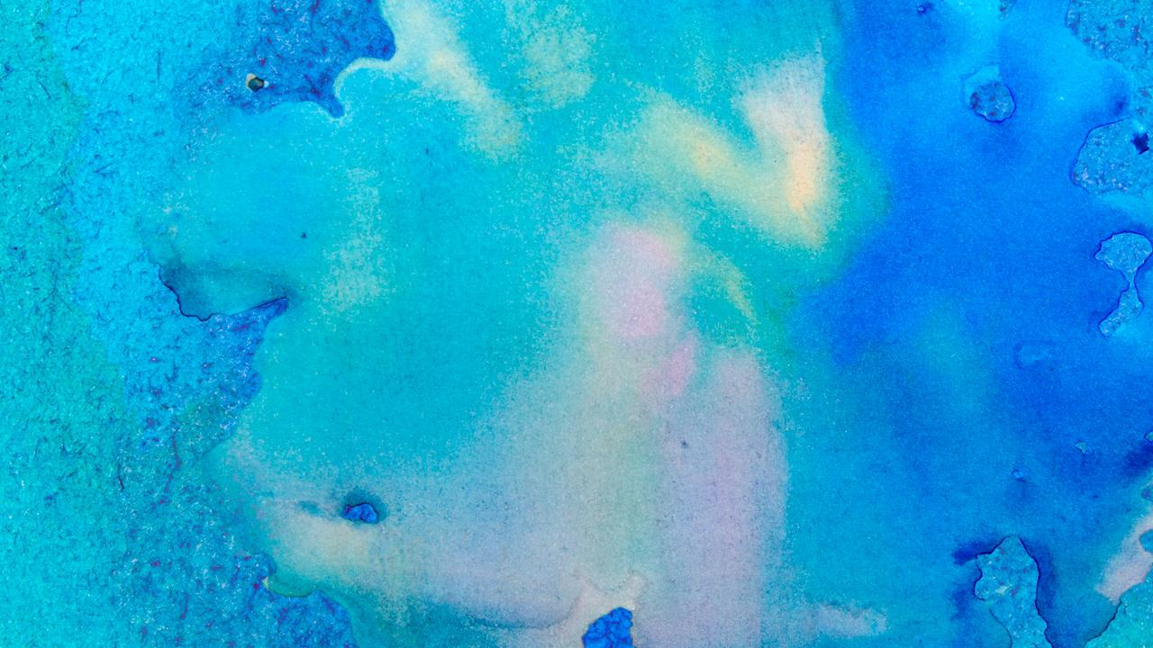
Maps
our office

Slide 35
89,526,124
Whoa! That’s a big number, aren’t you proud?

Slide 36
89,526,124$
185,244 users
100%
That’s a lot of money
And a lot of users
Total success!

Slide 37
Our process is easy
first
second
last

Slide 38
Let’s review some concepts
Yellow
Is the color of gold, butter and ripe lemons. In the spectrum of visible light, yellow is found between green and orange.
Blue
Is the colour of the clear sky and the deep sea. It is located between violet and green on the optical spectrum.
Red
Is the color of blood, and because of this it has historically been associated with sacrifice, danger and courage.
Yellow
Is the color of gold, butter and ripe lemons. In the spectrum of visible light, yellow is found between green and orange.
Blue
Is the colour of the clear sky and the deep sea. It is located between violet and green on the optical spectrum.
Red
Is the color of blood, and because of this it has historically been associated with sacrifice, danger and courage.

Slide 39
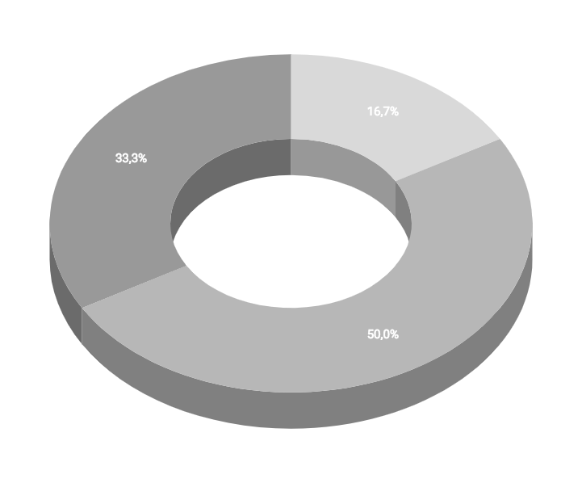
You can insert graphs from Google Sheets

Slide 40
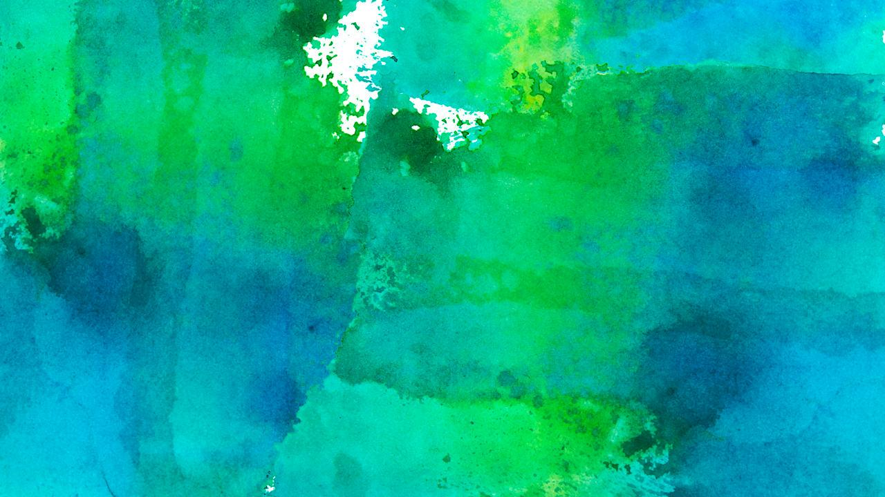
Android project
Show and explain your web, app or software projects using these gadget templates.
Place your screenshot here

Slide 41
iPhone project
Show and explain your web, app or software projects using these gadget templates.
Place your screenshot here

Slide 42
Tablet project
Show and explain your web, app or software projects using these gadget templates.
Place your screenshot here

Slide 43
Desktop project
Show and explain your web, app or software projects using these gadget templates.
Place your screenshot here

Slide 44
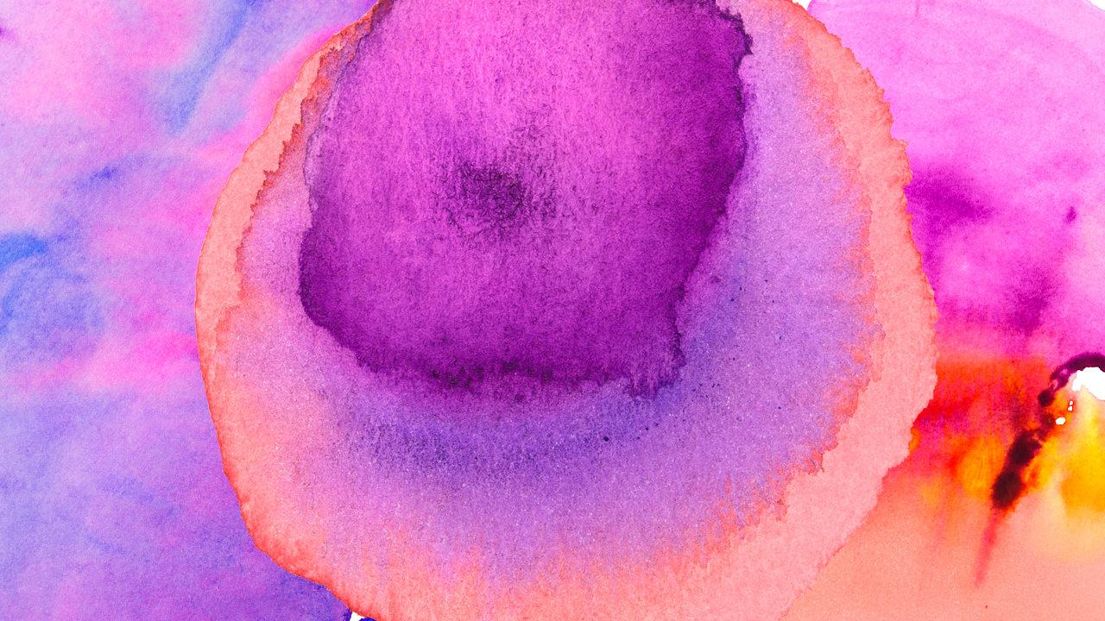
Thanks!
Any questions?
You can find me at:
@username
user@mail.me

Slide 45
Credits
Special thanks to all the people who made and released these awesome resources for free:
Presentation template by SlidesCarnival
Photographs by Unsplash
Watercolor textures by GraphicBurguer

Slide 46
Presentation design
This presentation uses the following typographies and colors:
Titles: Lato Thin
Body copy: Lato Light
You can download the fonts on this page:
http://www.latofonts.com/lato-free-fonts/
You don’t need to keep this slide in your presentation. It’s only here to serve you as a design guide if you need to create new slides or download the fonts to edit the presentation in PowerPoint®

Slide 47
SlidesCarnival icons are editable shapes.
This means that you can:
Resize them without losing quality.
Change fill color and opacity.
Isn’t that nice? :)
Examples:

Slide 48
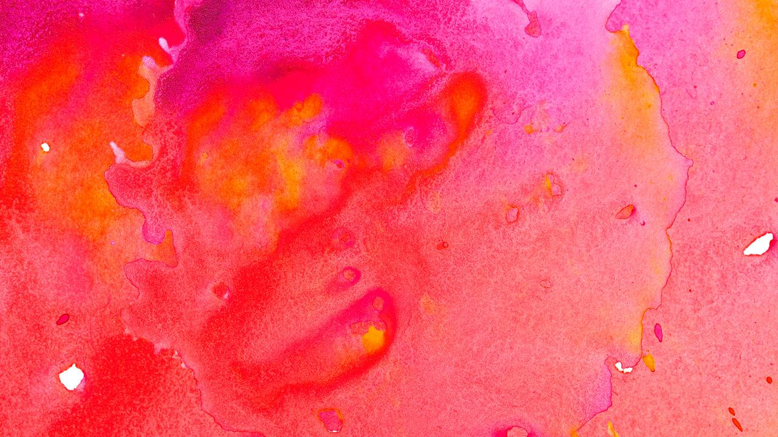
😉
Now you can use any emoji as an icon!
And of course it resizes without losing quality and you can change the color.
How? Follow Google instructions https://twitter.com/googledocs/status/730087240156643328
✋👆👉👍👤👦👧👨👩👪💃🏃💑❤😂😉😋😒😭👶😸🐟🍒🍔💣📌📖🔨🎃🎈🎨🏈🏰🌏🔌🔑 and many more...

